Slide 1

DQL
Data Query lANGUAGE

Slide 2
DEFINITION:
Database query languages allow the creation of database tables, read/write access to those tables, and many other functions.
we use to create, manage, deliver, and archive all type of contents from text documents and spreadsheets to digital images, HTML, and XML components.

Slide 3
TOPICS
SELECT Statement
WHERE clause
Distinct Clause
ORDER BY Clause

Slide 4


SELECT , FROM :
SELECT: This specifies the table columns that are retrived.
FROM clause. A from clause can have a sub query instead of a physical table or view. we will cover this in detail, don't get lost. We can also use Oracle functions or custom functions to return single value return functions.
Selecting ALL columns:

Slide 5

Select query real time example

Slide 6
WHERE, AS :
WHERE Clause: This is to filter the results of the entire select statement. you can exclude or include certain criteria. Apart from this you also join other tables with appropriate unique column to match appropriate record/row with appropriate record/ row in other table.
Select * from emp where dept=10;
AS Clause: This is used to specify a alternate column
Select dob as “Date of birth” from emp where dept=10;

Slide 7

Where- real time example

Slide 8
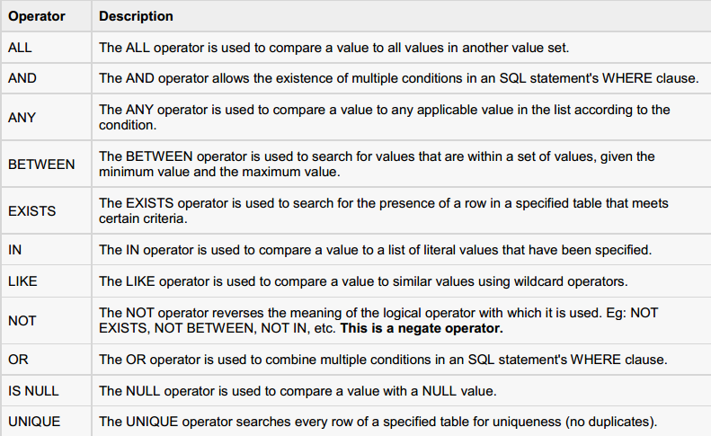
Operators:

Slide 9
DISTINCT,ORDER BY:
DISTINCT Clause: This is used to eliminate the duplicate rows
select distinct student_code from student_marks;
ORDER BY CLAUSE: A query with it’s various clauses determines the rows to be selected and the columns. The order of rows is not fixed unless an order clause is given.
select student, code, student, name, dept_ code from student_master order by student_Code desc;

Slide 10



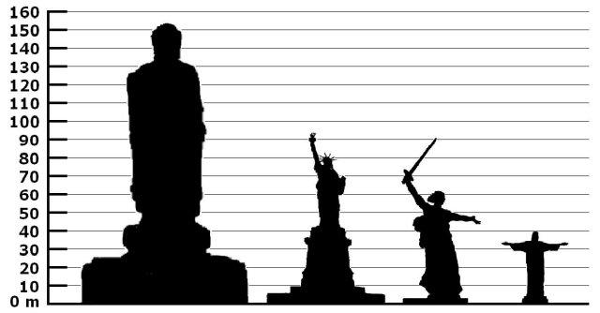
Real time scenarios

Slide 11


Conclusion:

